Slide 1
Logistic Regression
Il-Chul Moon Dept. of Industrial and Systems Engineering KAIST
icmoon@kaist.ac.kr

Slide 2
Weekly Objectives
Learn the logistic regression classifier
Understand why the logistic regression is better suited than the linear regression for classification tasks
Understand the logistic function
Understand the logistic regression classifier
Understand the approximation approach for the open form solutions
Learn the gradient descent algorithm
Know the tailor expansion
Understand the gradient descent/ascent algorithm
Learn the different between the naïve Bayes and the logistic regression
Understand the similarity of the two classifiers
Understand the differences of the two classifiers
Understand the performance differences

Slide 3
Logistic regression

Slide 4
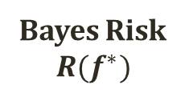
Optimal Classification and Bayes Risk
P(Y=y|X)
P(Y=y|X)
1
Bayes Risk
$$R(f^{∗})$$
0
X
Classify as y
Classify as y
Linear function vs. Non-linear function of P(Y|X)
Which is better?
Problems of linear function
Range
Risk optimization
Which function to use?
Need S-curve!
S-curve
a.k.a. Sigmoid function

Slide 5
Detour: Credit Approval Dataset
Some Counting Result
690 instances total
307 positive instances
Considering A1
98 positive when a
112 negative when a
206 positive when b
262 negative when b
3 positive when ?
9 negative when ?
Considering A9
284 positive when t
77 negative when t
23 positive when f
306 negative when f
http://archive.ics.uci.edu/ml/datasets/Credit+Approval
To protect the confidential information, the dataset is anonymized
Feature names and values, as well
A1: b, a. A2: continuous. A3: continuous. A4: u, y, l, t. A5: g, p, gg. A6: c, d, cc, i, j, k, m, r, q, w, x, e, aa, ff. A7: v, h, bb, j, n, z, dd, ff, o. A8: continuous. A9: t, f. A10: t, f. A11: continuous. A12: t, f. A13: g, p, s. A14: continuous. A15: continuous. C: +,- (class attribute)
A1 (307+,383-)
A9 (307+,383-)
a
b
?
t
f
98+,112-
206+,
262-
3+,9-
284+,77-
23+,306-
Which is a better attribute to include in the feature set of the hypothesis?

Slide 6
Classification with One Variable
Let’s predict the class, C, with an attribute, A15
Imagine that the Y axis shows P(Y|X)
There is a decision boundary
You can see it intuitively
Then, How to find the boundary?
X=A15, Y=C
X=log(A15), Y=C

Slide 7
Linear Function vs. Non-Linear Function
Problem of fitting to the linear function
Violate the probability axiom
Slow response to the examples
Better to fit to the logistic function
Keep the probability axiom
Quick response around the decision boundary
Which function to use?
Logistic function – a special case of sigmoid function
Blue = (X,Y_{true}), Red = (X,P_{lin}(Y|X)), Green=(X,P_{log}(Y|X))
Linear function
Logistic function
X=A15, Y=P(Y|X)
X=log(A15), Y=P(Y|X)

Slide 8
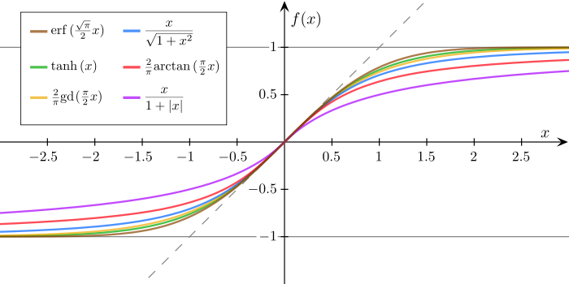


Logistic function
Many types of sigmoid functions
Sigmoid function is
Bounded
Differentiable
Real function
Defined for all real inputs
With positive derivative
Logistic function is
$f\left(x\right)=\frac{1}{1+e^{−x}}$
In relation to the population growth
Why is this good?
Sigmoid function
Particularly, easy to calculate the derivative…
Logistic Function
Logit Function
$$f\left(x\right)=log⁡(\frac{x}{1−x})$$

Slide 9

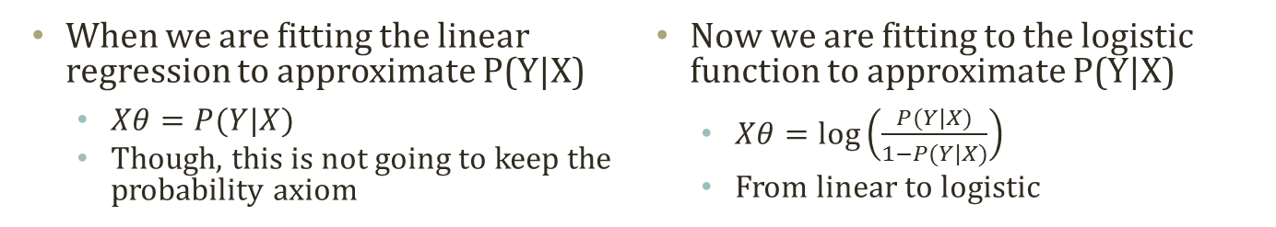

Logistic Function Fitting
Linear Regression:
$$\hat{f}=Xθ$$
$$θ={(X^{T}X)}^{−1}X^{T}Y$$
Very similar to the linear regression.
Turning to the multivariate case
Logit Function
Logistic Fitting
$$f\left(x\right)=\log\left(\frac{x}{1−x}\right)→x=\log\left(\frac{p}{1−p}\right)→ax+b=\log\left(\frac{p}{1−p}\right)→Xθ=\log\left(\frac{p}{1−p}\right)$$
Logit→Logistic
Inverse of X and Y
X in Logit is the probability
Linear shift for a better function fitting
When we are fitting the linear regression to approximate P(Y|X)
$Xθ=P(Y|X)$
Though, this is not going to keep the probability axiom
Now we are fitting to the logistic function to approximate P(Y|X)
$Xθ=\log\left(\frac{P(Y|X)}{1−P(Y|X)}\right)$
From linear to logistic

Slide 10
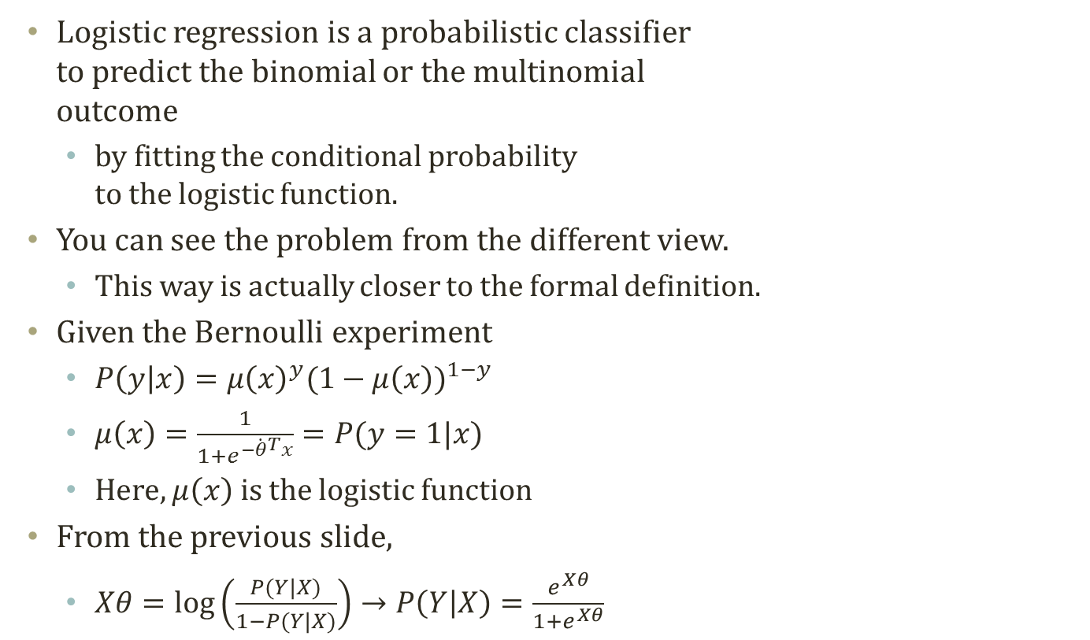

Logistic Regression
Y=0
Y=1
Logistic regression is a probabilistic classifier to predict the binomial or the multinomial outcome
by fitting the conditional probability to the logistic function.
You can see the problem from the different view.
This way is actually closer to the formal definition.
Given the Bernoulli experiment
$P\left(y | x\right)={μ\left(x\right)}^{y}{(1−μ\left(x\right))}^{1−y}$
$μ\left(x\right)=\frac{1}{1+e^{−{\dot{θ}}^{T}x}}=P(y=1|x)$
Here, $μ\left(x\right)$ is the logistic function
From the previous slide,
$Xθ=\log\left(\frac{P(Y|X)}{1−P(Y|X)}\right)→P\left(Y | X\right)=\frac{e^{Xθ}}{1+e^{Xθ}}$
Logistic Function
$$f\left(x\right)=\frac{1}{1+e^{−x}}$$
The goal, finally, becomes finding out θ, again

Slide 11
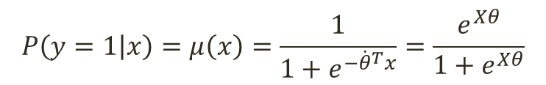
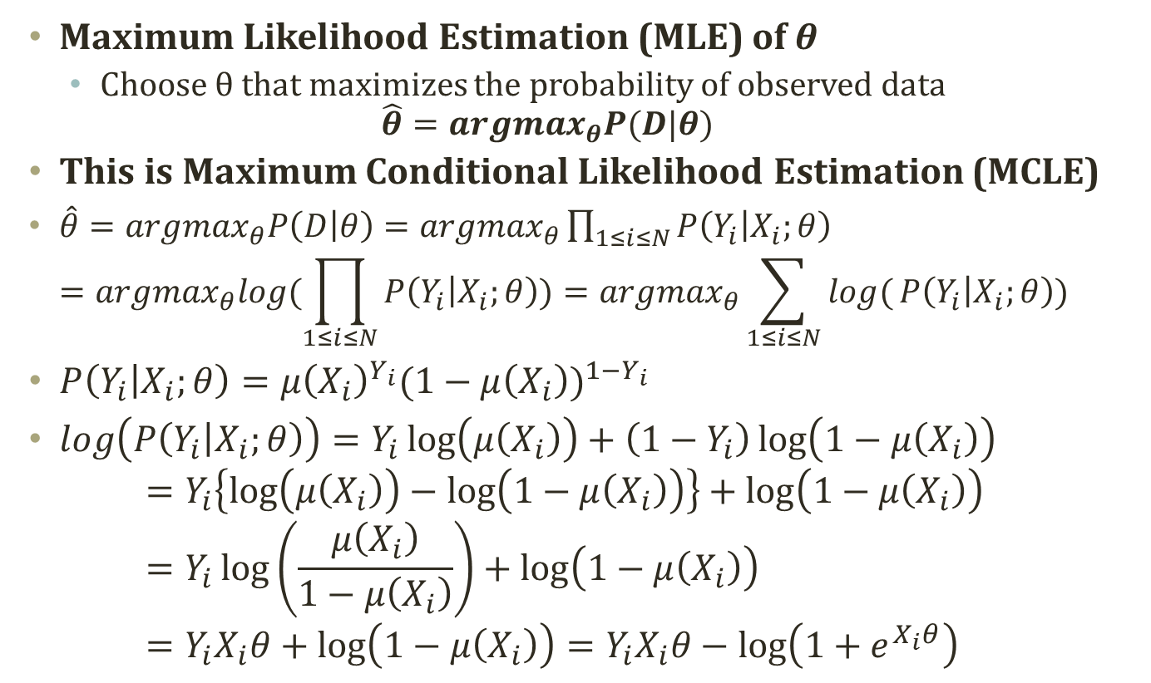
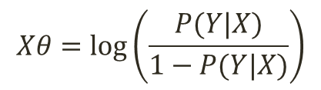
Finding the Parameter, θ
$$P\left(y=1 | x\right)=μ\left(x\right)=\frac{1}{1+e^{−{\dot{θ}}^{T}x}}=\frac{e^{Xθ}}{1+e^{Xθ}}$$
$$Xθ=\log\left(\frac{P(Y|X)}{1−P(Y|X)}\right)$$
Maximum Likelihood Estimation (MLE) of θ
Choose θ that maximizes the probability of observed data $\hat{θ}={argmax}_{θ}P(D|θ)$
This is Maximum Conditional Likelihood Estimation (MCLE)
$\hat{θ}={argmax}_{θ}P\left(D | θ\right)={argmax}_{θ}\prod_{1≤i≤N}{P\left(Y_{i} | X_{i};θ\right)}$ $={argmax}_{θ}log(\prod_{1≤i≤N}{P\left(Y_{i} | X_{i};θ\right)})={argmax}_{θ}\sum_{1≤i≤N}{log(}P\left(Y_{i} | X_{i};θ\right))$
$P\left(Y_{i} | X_{i};θ\right)={μ\left(X_{i}\right)}^{Y_{i}}{(1−μ\left(X_{i}\right))}^{1−Y_{i}}$
$log\left(P\left(Y_{i} | X_{i};θ\right)\right)=Y_{i}\log\left(μ\left(X_{i}\right)\right)+\left(1−Y_{i}\right)\log\left(1−μ\left(X_{i}\right)\right)$ $=Y_{i}\left\{\log\left(μ\left(X_{i}\right)\right)−\log\left(1−μ\left(X_{i}\right)\right)\right\}+\log\left(1−μ\left(X_{i}\right)\right)$ $=Y_{i}\log\left(\frac{μ\left(X_{i}\right)}{1−μ\left(X_{i}\right)}\right)+\log\left(1−μ\left(X_{i}\right)\right)$ $=Y_{i}X_{i}θ+\log\left(1−μ\left(X_{i}\right)\right)=Y_{i}X_{i}θ−\log\left(1+e^{X_{i}θ}\right)$

Slide 12
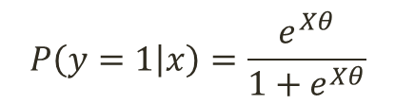
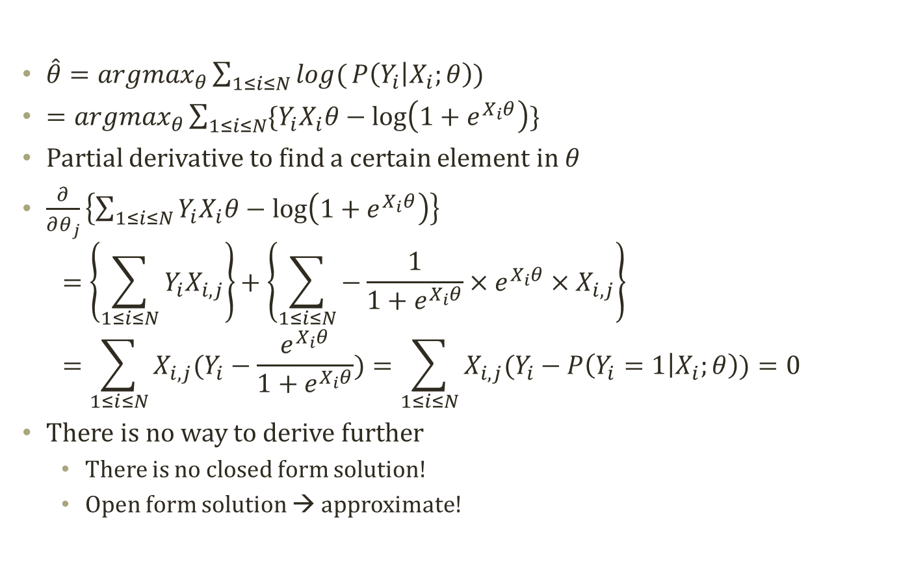
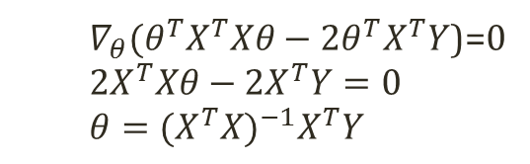

Finding the Parameter, θ, contd.
Linear Regression (Closed Form):
$$\hat{f}=Xθ$$
$∇_{θ}(θ^{T}X^{T}Xθ−2θ^{T}X^{T}Y$)=0
$$2X^{T}Xθ−2X^{T}Y=0$$
$$θ={(X^{T}X)}^{−1}X^{T}Y$$
$\hat{θ}={argmax}_{θ}\sum_{1≤i≤N}{log(}P\left(Y_{i} | X_{i};θ\right))$
$={argmax}_{θ}\sum_{1≤i≤N}{\{Y_{i}X_{i}θ−\log\left(1+e^{X_{i}θ}\right)\}}$
Partial derivative to find a certain element in $θ$
$\frac{∂}{∂θ_{j}}\left\{\sum_{1≤i≤N}{Y_{i}X_{i}θ−\log\left(1+e^{X_{i}θ}\right)}\right\}$ $=\left\{\sum_{1≤i≤N}{Y_{i}X_{i,j}}\right\}+\left\{\sum_{1≤i≤N}{−\frac{1}{1+e^{X_{i}θ}}×e^{X_{i}θ}×X_{i,j}}\right\}$ $=\sum_{1≤i≤N}{X_{i,j}(Y_{i}−\frac{e^{X_{i}θ}}{1+e^{X_{i}θ}})}=\sum_{1≤i≤N}{X_{i,j}(Y_{i}−P\left(Y_{i}=1 | X_{i};θ\right))}=0$
There is no way to derive further
There is no closed form solution!
Open form solution → approximate!
$$P\left(y=1 | x\right)=\frac{e^{Xθ}}{1+e^{Xθ}}$$
Cannot be easily solved in the closed form because of the logistic function

Slide 13
Gradient method

Slide 14
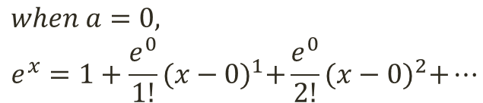
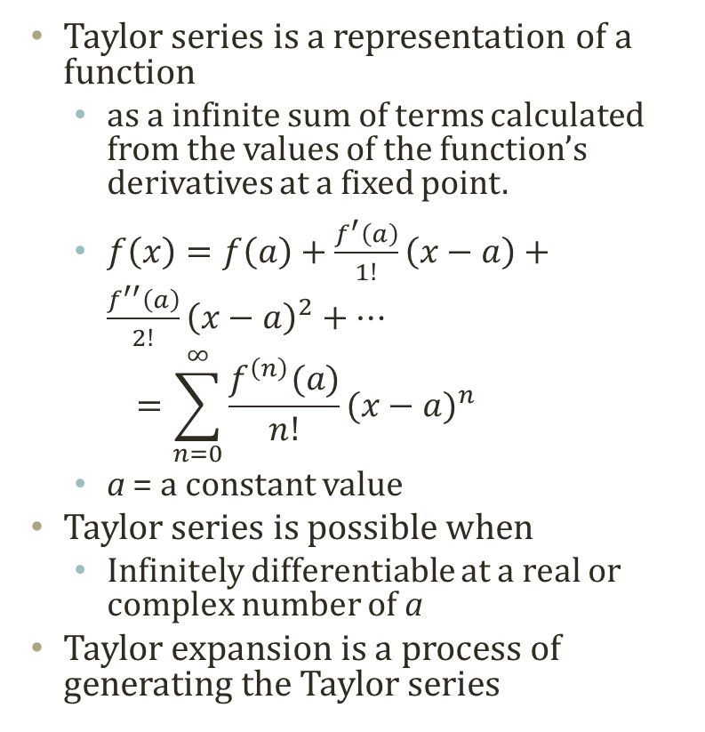
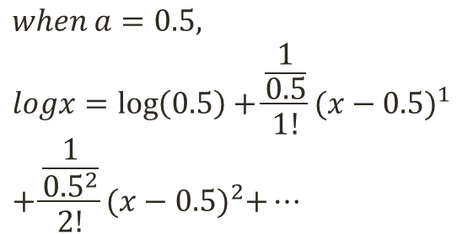
Taylor Expansion
$$when a=0, \\ e^{x}=1+\frac{e^{0}}{1!}{(x−0)}^{1}+\frac{e^{0}}{2!}{(x−0)}^{2}+…$$
n=2
n=4
Taylor series is a representation of a function
as a infinite sum of terms calculated from the values of the function’s derivatives at a fixed point.
$f\left(x\right)=f\left(a\right)+\frac{f^{′}\left(a\right)}{1!}\left(x−a\right)+\frac{f^{′′}\left(a\right)}{2!}{\left(x−a\right)}^{2}+…$ $=\sum_{n=0}^{∞}{\frac{f^{\left(n\right)}(a)}{n!}{(x−a)}^{n}}$
a = a constant value
Taylor series is possible when
Infinitely differentiable at a real or complex number of a
Taylor expansion is a process of generating the Taylor series
$$when a=0.5, \\ logx=\log\left(0.5\right)+\frac{\frac{1}{0.5}}{1!}{(x−0.5)}^{1} \\ +\frac{\frac{1}{{0.5}^{2}}}{2!}{(x−0.5)}^{2}+…$$
n=100
n=2

Slide 15
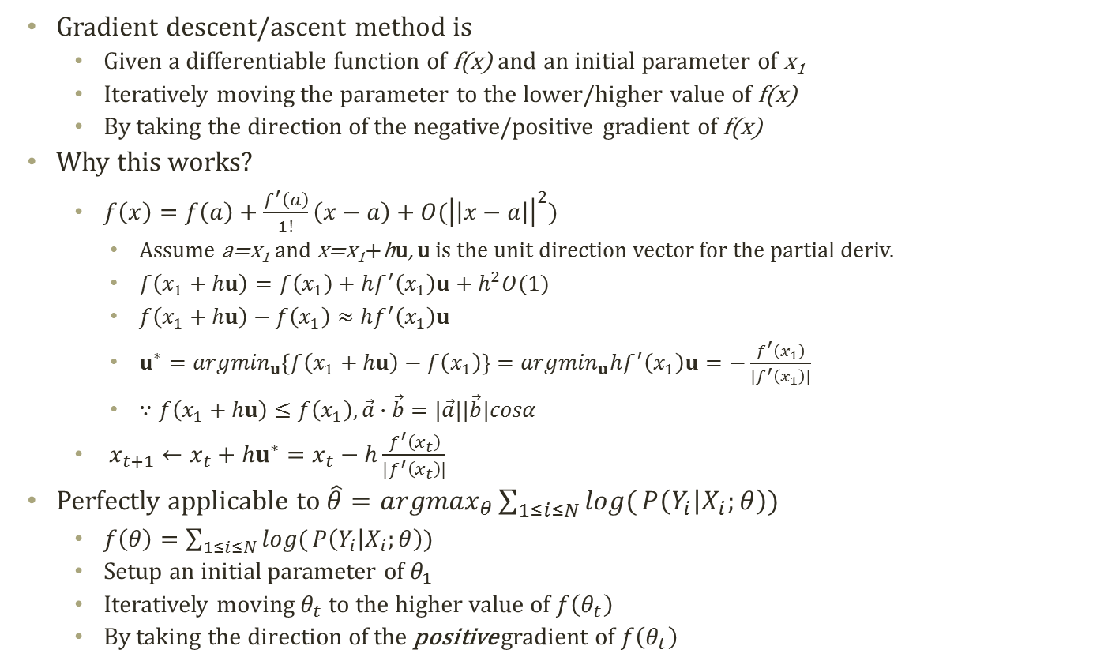
Gradient Descent/Ascent
Gradient descent/ascent method is
Given a differentiable function of f(x) and an initial parameter of x₁
Iteratively moving the parameter to the lower/higher value of f(x)
By taking the direction of the negative/positive gradient of f(x)
Why this works?
$f\left(x\right)=f\left(a\right)+\frac{f^{′}\left(a\right)}{1!}\left(x−a\right)+O({\left|\left|x−a\right|\right|}^{2})$
Assume a=x₁ and x=x₁+hu, u is the unit direction vector for the partial deriv.
$f\left(x_{1}+hu\right)=f\left(x_{1}\right)+hf^{′}\left(x_{1}\right)u+h^{2}O(1)$
$f\left(x_{1}+hu\right)−f\left(x_{1}\right)≈hf^{′}\left(x_{1}\right)u$
$u^{∗}={argmin}_{u}\left\{f\left(x_{1}+hu\right)−f\left(x_{1}\right)\right\}={argmin}_{u}hf^{′}\left(x_{1}\right)u=−\frac{f^{′}\left(x_{1}\right)}{|f^{′}\left(x_{1}\right)|}$
$∵f\left(x_{1}+hu\right)≤f\left(x_{1}\right),\vec{a}∙\vec{b}=|\vec{a}||\vec{b}|cosα$
$x_{t+1}←x_{t}+{hu}^{∗}=x_{t}−h\frac{f^{′}\left(x_{t}\right)}{|f^{′}\left(x_{t}\right)|}$
Perfectly applicable to $\hat{θ}={argmax}_{θ}\sum_{1≤i≤N}{log(}P\left(Y_{i} | X_{i};θ\right))$
$f\left(θ\right)=\sum_{1≤i≤N}{log(}P\left(Y_{i} | X_{i};θ\right))$
Setup an initial parameter of $θ_{1}$
Iteratively moving $θ_{t}$ to the higher value of $f\left(θ_{t}\right)$
By taking the direction of the positive gradient of $f\left(θ_{t}\right)$
Useful Big-Oh Notation
Always???
Gradient Descent
Gradient Ascent

Slide 16
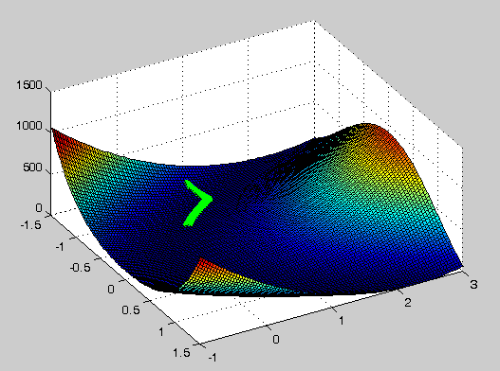
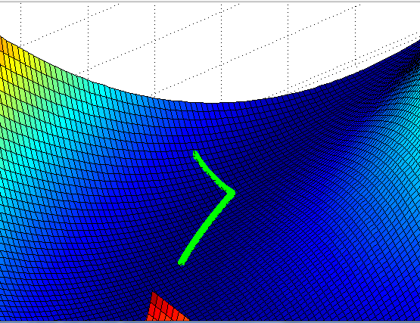
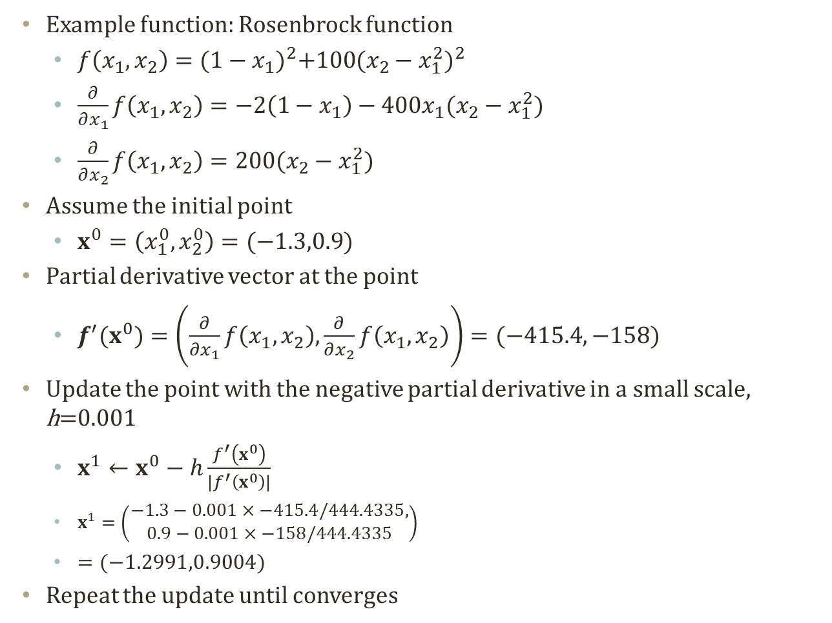
How Gradient Descent Works
Example function: Rosenbrock function
$f\left(x_{1},x_{2}\right)={(1−x_{1})}^{2}+{100(x_{2}−x_{1}^{2})}^{2}$
$\frac{∂}{∂x_{1}}f\left(x_{1},x_{2}\right)=−2\left(1−x_{1}\right)−400x_{1}(x_{2}−x_{1}^{2})$
$\frac{∂}{∂x_{2}}f\left(x_{1},x_{2}\right)=200(x_{2}−x_{1}^{2})$
Assume the initial point
$x^{0}=\left(x_{1}^{0},x_{2}^{0}\right)=(−1.3,0.9)$
Partial derivative vector at the point
$f^{′}(x^{0})=\left(\frac{∂}{∂x_{1}}f\left(x_{1},x_{2}\right),\frac{∂}{∂x_{2}}f\left(x_{1},x_{2}\right)\right)=(−415.4,−158)$
Update the point with the negative partial derivative in a small scale, h=0.001
$x^{1}←x^{0}−h\frac{f^{′}\left(x^{0}\right)}{|f^{′}\left(x^{0}\right)|}$
$x^{1}=\left(\begin{aligned}−1.3−0.001×−415.4/444.4335, \\ 0.9−0.001×−158/444.4335\end{aligned}\right)$
$=(−1.2991,0.9004)$
Repeat the update until converges
Global Minimum=0 at (1,1)

Slide 17
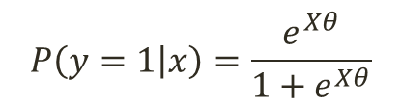
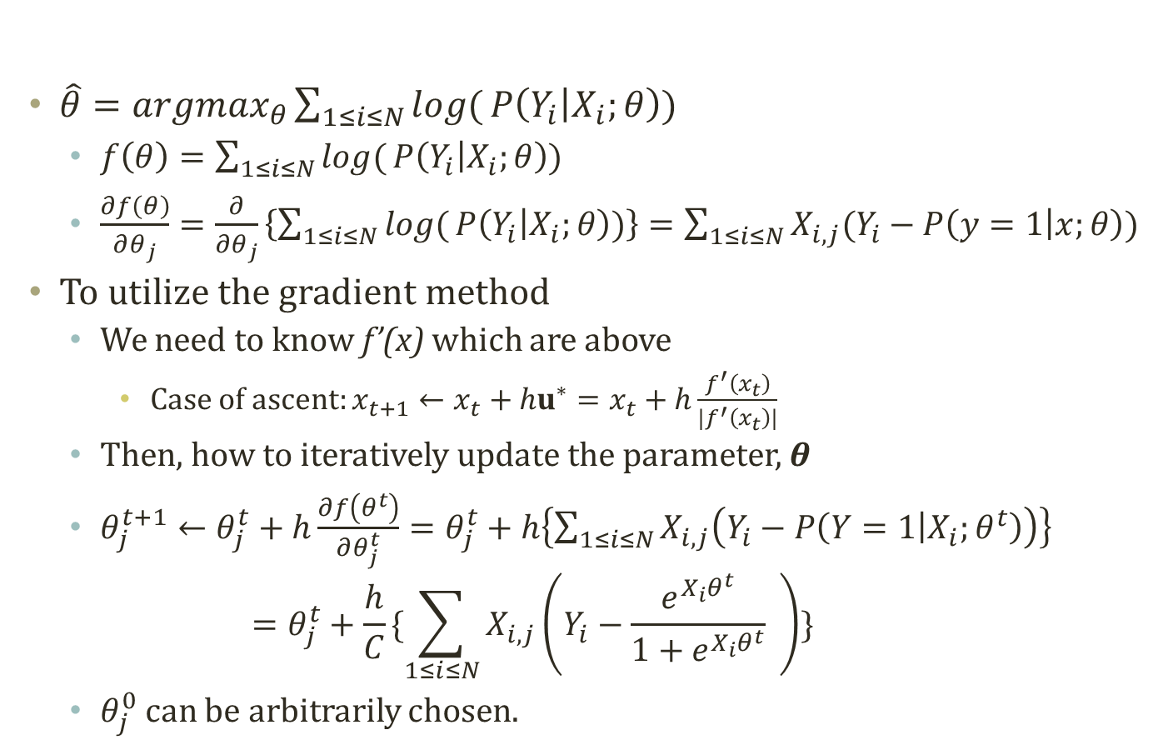
Finding θ with Gradient Ascent
$$P\left(y=1 | x\right)=\frac{e^{Xθ}}{1+e^{Xθ}}$$
$\hat{θ}={argmax}_{θ}\sum_{1≤i≤N}{log(}P\left(Y_{i} | X_{i};θ\right))$
$f\left(θ\right)=\sum_{1≤i≤N}{log(}P\left(Y_{i} | X_{i};θ\right))$
$\frac{∂f\left(θ\right)}{∂θ_{j}}=\frac{∂}{∂θ_{j}}\left\{\sum_{1≤i≤N}{log(}P\left(Y_{i} | X_{i};θ\right))\right\}=\sum_{1≤i≤N}{X_{i,j}(Y_{i}−P\left(y=1 | x;θ\right))}$
To utilize the gradient method
We need to know f’(x) which are above
Case of ascent: $x_{t+1}←x_{t}+{hu}^{∗}=x_{t}+h\frac{f^{′}\left(x_{t}\right)}{|f^{′}\left(x_{t}\right)|}$
Then, how to iteratively update the parameter, θ
$θ_{j}^{t+1}←θ_{j}^{t}+h\frac{∂f\left(θ^{t}\right)}{∂θ_{j}^{t}}=θ_{j}^{t}+h\left\{\sum_{1≤i≤N}{X_{i,j}\left(Y_{i}−P\left(Y=1 | X_{i};θ^{t}\right)\right)}\right\}$ $=θ_{j}^{t}+\frac{h}{C}\{\sum_{1≤i≤N}{X_{i,j}\left(Y_{i}−\frac{e^{X_{i}θ^{t}}}{1+e^{X_{i}θ^{t}}} \right)}\}$
$θ_{j}^{0}$ can be arbitrarily chosen.
C=Normalization to the unit vector

Slide 18
Logistic Regression Matlab Exercise
Let’s do some coding…

Slide 19
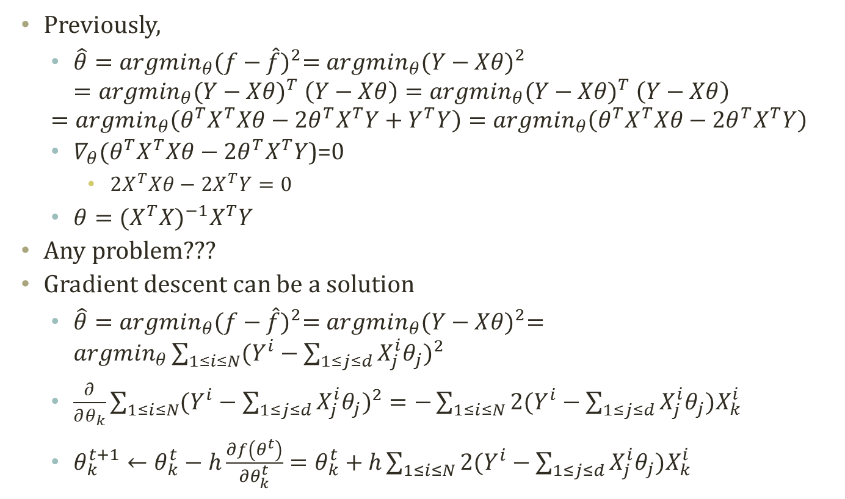
Linear Regression Revisited
Previously,
$\hat{θ}={argmin}_{θ}{(f−\hat{f})}^{2}={argmin}_{θ}{(Y−Xθ)}^{2}$ $={argmin}_{θ}{(Y−Xθ)}^{T}$ $\left(Y−Xθ\right)={argmin}_{θ}{(Y−Xθ)}^{T} \left(Y−Xθ\right)$
$$={argmin}_{θ}\left(θ^{T}X^{T}Xθ−2θ^{T}X^{T}Y+Y^{T}Y\right)={argmin}_{θ}\left(θ^{T}X^{T}Xθ−2θ^{T}X^{T}Y\right)$$
$∇_{θ}(θ^{T}X^{T}Xθ−2θ^{T}X^{T}Y$)=0
$2X^{T}Xθ−2X^{T}Y=0$
$θ={(X^{T}X)}^{−1}X^{T}Y$
Any problem???
Gradient descent can be a solution
$\hat{θ}={argmin}_{θ}{(f−\hat{f})}^{2}={argmin}_{θ}{(Y−Xθ)}^{2}={argmin}_{θ}\sum_{1≤i≤N}{{(Y^{i}−\sum_{1≤j≤d}{X_{j}^{i}θ_{j}})}^{2}}$
$\frac{∂}{∂θ_{k}}\sum_{1≤i≤N}{{(Y^{i}−\sum_{1≤j≤d}{X_{j}^{i}θ_{j}})}^{2}}=−\sum_{1≤i≤N}{2(Y^{i}−\sum_{1≤j≤d}{X_{j}^{i}θ_{j}})X_{k}^{i}}$
$θ_{k}^{t+1}←θ_{k}^{t}−h\frac{∂f\left(θ^{t}\right)}{∂θ_{k}^{t}}=θ_{k}^{t}+h\sum_{1≤i≤N}{2(Y^{i}−\sum_{1≤j≤d}{X_{j}^{i}θ_{j}})X_{k}^{i}}$

Slide 20
Naïve bayes vs. logistic regression

Slide 21
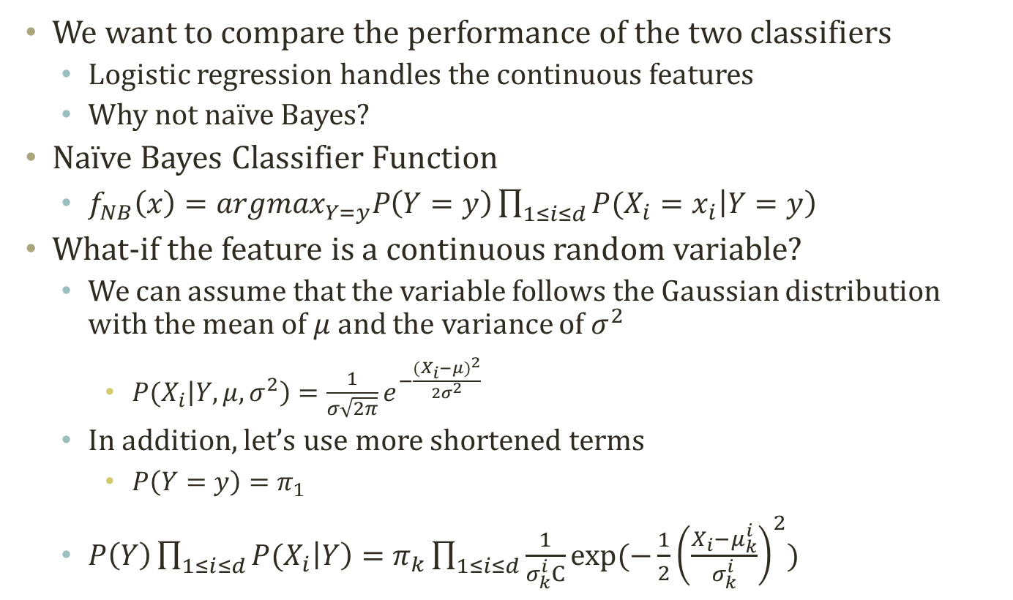
Gaussian Naïve Bayes
We want to compare the performance of the two classifiers
Logistic regression handles the continuous features
Why not naïve Bayes?
Naïve Bayes Classifier Function
$f_{NB}\left(x\right)={argmax}_{Y=y}P\left(Y=y\right)\prod_{1≤i≤d}{P(X_{i}=x_{i}\left|Y=y\right)}$
What-if the feature is a continuous random variable?
We can assume that the variable follows the Gaussian distribution with the mean of $μ$ and the variance of $σ^{2}$
$P(X_{i}\left|Y,μ,σ^{2}\right)=\frac{1}{σ\sqrt{2π}}e^{−\frac{{(X_{i}−μ)}^{2}}{2σ^{2}}}$
In addition, let’s use more shortened terms
$P\left(Y=y\right)=π_{1}$
$P\left(Y\right)\prod_{1≤i≤d}{P(X_{i}\left|Y\right)}=π_{k}\prod_{1≤i≤d}{\frac{1}{σ_{k}^{i}C}exp⁡(−\frac{1}{2}{\left(\frac{X_{i}−μ_{k}^{i}}{σ_{k}^{i}}\right)}^{2})}$

Slide 22
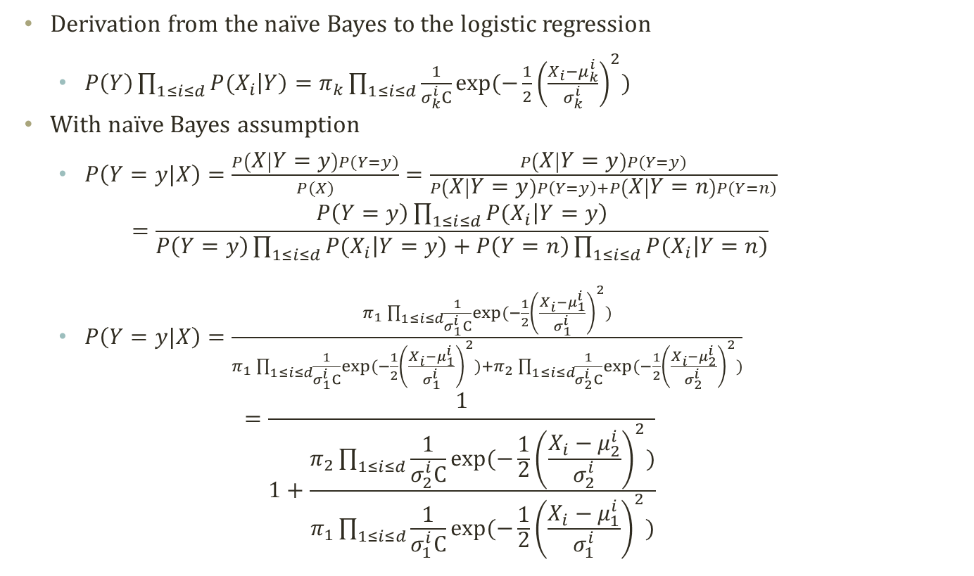
Derivation to Logistic Regression (1)
Derivation from the naïve Bayes to the logistic regression
$P\left(Y\right)\prod_{1≤i≤d}{P(X_{i}\left|Y\right)}=π_{k}\prod_{1≤i≤d}{\frac{1}{σ_{k}^{i}C}exp⁡(−\frac{1}{2}{\left(\frac{X_{i}−μ_{k}^{i}}{σ_{k}^{i}}\right)}^{2})}$
With naïve Bayes assumption
$P\left(Y=y|X\right)=\frac{P\left(X | Y=y\right)P(Y=y)}{P(X)}=\frac{P\left(X | Y=y\right)P(Y=y)}{P\left(X | Y=y\right)P\left(Y=y\right)+P\left(X | Y=n\right)P(Y=n)}$ $=\frac{P\left(Y=y\right)\prod_{1≤i≤d}{P(X_{i}\left|Y=y\right)}}{P\left(Y=y\right)\prod_{1≤i≤d}{P(X_{i}\left|Y=y\right)}+P\left(Y=n\right)\prod_{1≤i≤d}{P(X_{i}\left|Y=n\right)}}$
$P\left(Y=y|X\right)=\frac{π_{1}\prod_{1≤i≤d}{\frac{1}{σ_{1}^{i}C}exp⁡(−\frac{1}{2}{\left(\frac{X_{i}−μ_{1}^{i}}{σ_{1}^{i}}\right)}^{2})}}{π_{1}\prod_{1≤i≤d}{\frac{1}{σ_{1}^{i}C}exp⁡(−\frac{1}{2}{\left(\frac{X_{i}−μ_{1}^{i}}{σ_{1}^{i}}\right)}^{2})}+π_{2}\prod_{1≤i≤d}{\frac{1}{σ_{2}^{i}C}exp⁡(−\frac{1}{2}{\left(\frac{X_{i}−μ_{2}^{i}}{σ_{2}^{i}}\right)}^{2})}}$ $=\frac{1}{1+\frac{π_{2}\prod_{1≤i≤d}{\frac{1}{σ_{2}^{i}C}exp⁡(−\frac{1}{2}{\left(\frac{X_{i}−μ_{2}^{i}}{σ_{2}^{i}}\right)}^{2})}}{π_{1}\prod_{1≤i≤d}{\frac{1}{σ_{1}^{i}C}exp⁡(−\frac{1}{2}{\left(\frac{X_{i}−μ_{1}^{i}}{σ_{1}^{i}}\right)}^{2})}}}$

Slide 23
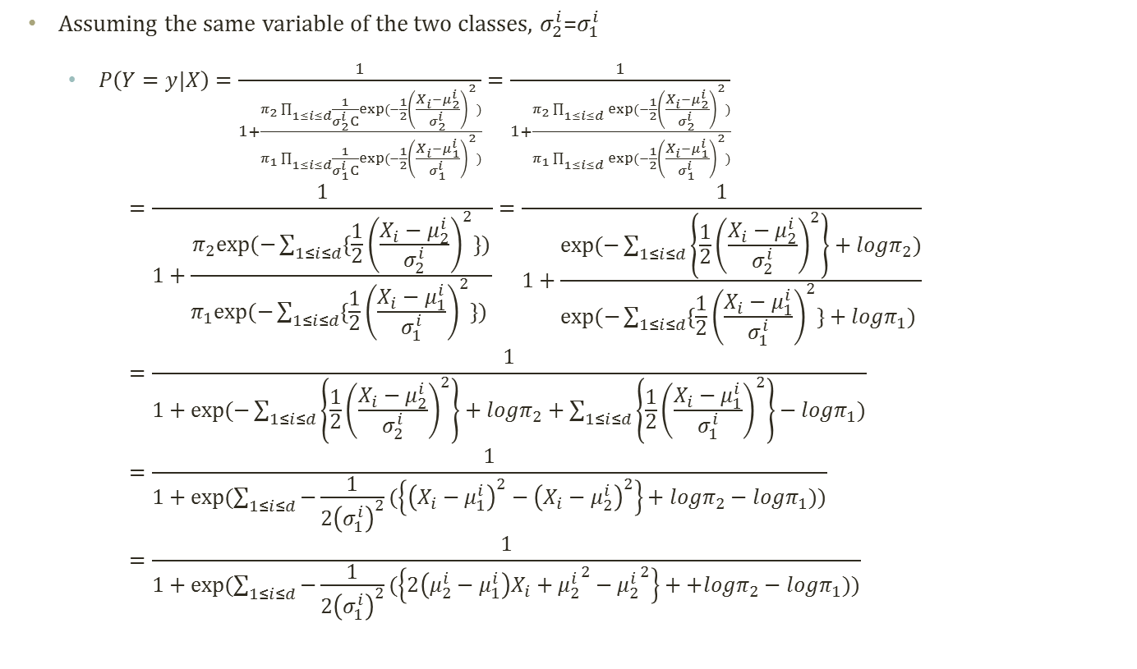
Derivation to Logistic Regression (2)
Assuming the same variable of the two classes, $σ_{2}^{i}$=$σ_{1}^{i}$
$P\left(Y=y|X\right)=\frac{1}{1+\frac{π_{2}\prod_{1≤i≤d}{\frac{1}{σ_{2}^{i}C}exp⁡(−\frac{1}{2}{\left(\frac{X_{i}−μ_{2}^{i}}{σ_{2}^{i}}\right)}^{2})}}{π_{1}\prod_{1≤i≤d}{\frac{1}{σ_{1}^{i}C}exp⁡(−\frac{1}{2}{\left(\frac{X_{i}−μ_{1}^{i}}{σ_{1}^{i}}\right)}^{2})}}}=\frac{1}{1+\frac{π_{2}\prod_{1≤i≤d}{exp⁡(−\frac{1}{2}{\left(\frac{X_{i}−μ_{2}^{i}}{σ_{2}^{i}}\right)}^{2})}}{π_{1}\prod_{1≤i≤d}{exp⁡(−\frac{1}{2}{\left(\frac{X_{i}−μ_{1}^{i}}{σ_{1}^{i}}\right)}^{2})}}}$ $=\frac{1}{1+\frac{π_{2}exp⁡(−\sum_{1≤i≤d}{\{\frac{1}{2}{\left(\frac{X_{i}−μ_{2}^{i}}{σ_{2}^{i}}\right)}^{2}\}})}{π_{1}exp⁡(−\sum_{1≤i≤d}{\{\frac{1}{2}{\left(\frac{X_{i}−μ_{1}^{i}}{σ_{1}^{i}}\right)}^{2}\}}) }}=\frac{1}{1+\frac{exp⁡(−\sum_{1≤i≤d}{\left\{\frac{1}{2}{\left(\frac{X_{i}−μ_{2}^{i}}{σ_{2}^{i}}\right)}^{2}\right\}}+logπ_{2})}{exp⁡(−\sum_{1≤i≤d}{\{\frac{1}{2}{\left(\frac{X_{i}−μ_{1}^{i}}{σ_{1}^{i}}\right)}^{2}\}+logπ_{1}}) }}=\frac{1}{1+exp⁡(−\sum_{1≤i≤d}{\left\{\frac{1}{2}{\left(\frac{X_{i}−μ_{2}^{i}}{σ_{2}^{i}}\right)}^{2}\right\}}+logπ_{2}+\sum_{1≤i≤d}{\left\{\frac{1}{2}{\left(\frac{X_{i}−μ_{1}^{i}}{σ_{1}^{i}}\right)}^{2}\right\}−logπ_{1}})}=\frac{1}{1+exp⁡(\sum_{1≤i≤d}{−\frac{1}{2{\left(σ_{1}^{i}\right)}^{2}}(\left\{{\left(X_{i}−μ_{1}^{i}\right)}^{2}−{\left(X_{i}−μ_{2}^{i}\right)}^{2}\right\}+logπ_{2}−logπ_{1})})}=\frac{1}{1+exp⁡(\sum_{1≤i≤d}{−\frac{1}{2{\left(σ_{1}^{i}\right)}^{2}}(\left\{2\left(μ_{2}^{i}−μ_{1}^{i}\right)X_{i}+{μ_{2}^{i}}^{2}−{μ_{2}^{i}}^{2}\right\}++logπ_{2}−logπ_{1})})}$

Slide 24
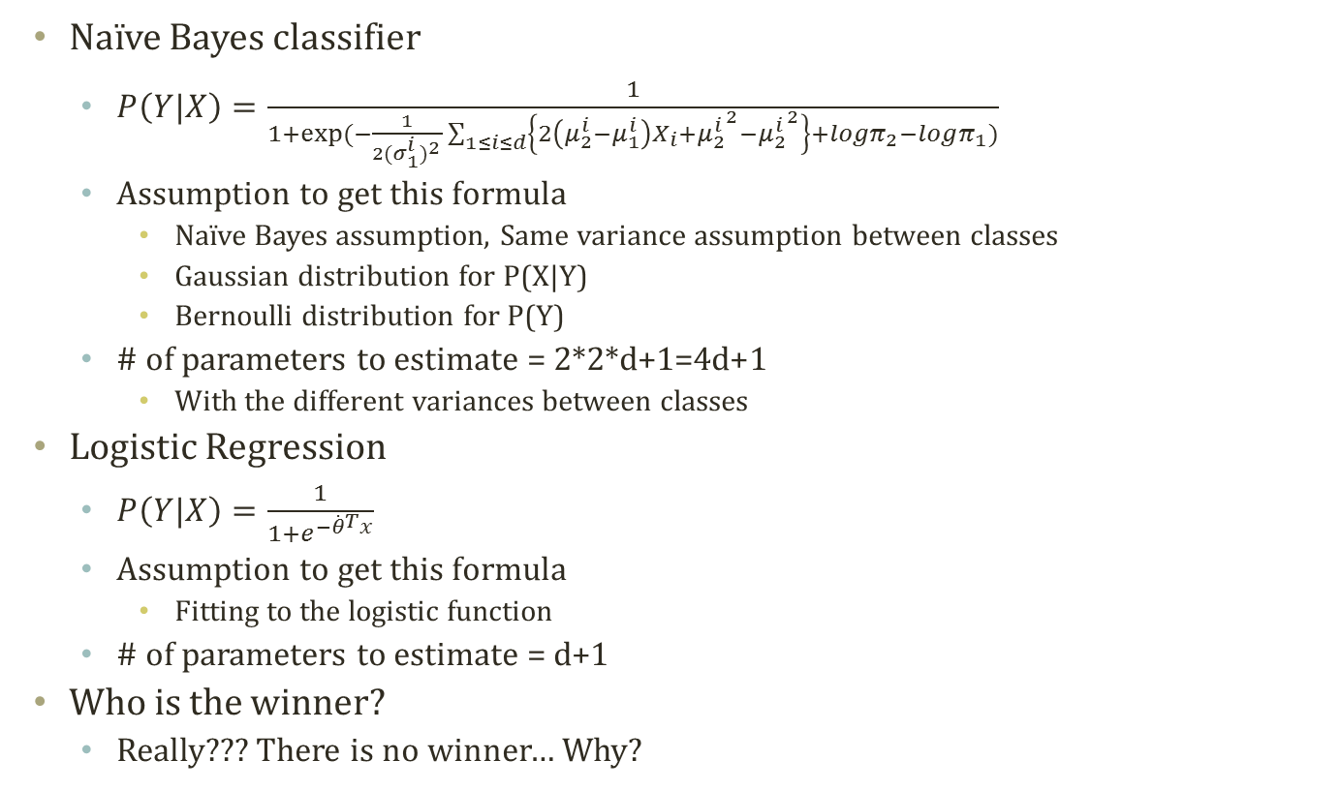
Naïve Bayes vs. Logistic Regression
Naïve Bayes classifier
$P\left(Y|X\right)=\frac{1}{1+exp⁡(−\frac{1}{2{(σ_{1}^{i})}^{2}}\sum_{1≤i≤d}{\left\{2\left(μ_{2}^{i}−μ_{1}^{i}\right)X_{i}+{μ_{2}^{i}}^{2}−{μ_{2}^{i}}^{2}\right\}}+logπ_{2}−logπ_{1})}$
Assumption to get this formula
Naïve Bayes assumption, Same variance assumption between classes
Gaussian distribution for P(X|Y)
Bernoulli distribution for P(Y)
# of parameters to estimate = 2*2*d+1=4d+1
With the different variances between classes
Logistic Regression
$P\left(Y|X\right)=\frac{1}{1+e^{−{\dot{θ}}^{T}x}}$
Assumption to get this formula
Fitting to the logistic function
# of parameters to estimate = d+1
Who is the winner?
Really??? There is no winner… Why?
Together, modeling joint prob.

Slide 25
Generative-Discriminative Pair
Generative model, P(Y|X)=P(X,Y)/P(X)=P(X|Y)P(Y)/P(X)
Full probabilistic model of all variables
Estimate the parameters of P(X|Y), P(Y) from the data
Characteristics: Bayesian, Prior, Modeling the joint probability
Naïve Bayes Classifier
Discriminative model, P(Y|X)
Do not need to model the distribution of the observed variables
Estimate the parameters of P(Y|X) from the data
Characteristics: Modeling the conditional probability
Logistic Regression
Pros and Cons [Ng & Jordan, 2002]
Logistic regression is less biased
Probably approximately correct learning: Naïve Bayes learns faster

Slide 26
Acknowledgement
This slideset is greatly influenced
By Prof. Carlos Guestrin at CMU
By Prof. Eric Xing at CMU
By Prof. Tom Mitchell at CMU

Slide 27
Further Readings
Bishop Chapter 4.3, 5.2.1-5.2.4

Slide 28
Detour: Credit Approval Dataset
A1: b, a. A2: continuous. A3: continuous. A4: u, y, l, t. A5: g, p, gg. A6: c, d, cc, i, j, k, m, r, q, w, x, e, aa, ff. A7: v, h, bb, j, n, z, dd, ff, o. A8: continuous. A9: t, f. A10: t, f. A11: continuous. A12: t, f. A13: g, p, s. A14: continuous. A15: continuous. C: +,- (class attribute)
http://archive.ics.uci.edu/ml/datasets/Credit+Approval
To protect the confidential information, the dataset is anonymized
Feature names and values, as well
A1: b, a. A2: continuous. A3: continuous. A4: u, y, l, t. A5: g, p, gg. A6: c, d, cc, i, j, k, m, r, q, w, x, e, aa, ff. A7: v, h, bb, j, n, z, dd, ff, o. A8: continuous. A9: t, f. A10: t, f. A11: continuous. A12: t, f. A13: g, p, s. A14: continuous. A15: continuous. C: +,- (class attribute)
A1 (307+,383-)
A9 (307+,383-)
a
b
?
t
f
98+,112-
206+,
262-
3+,9-
284+,77-
23+,306-
Which is a better attribute to include in the feature set of the hypothesis?

